Slide 1
Cloud Computing

Slide 2
What is Cloud Computing?
Cloud computing is a model for enabling convenient, on-demand network access to a shared pool of configurable computing resources (e.g., networks, servers, storage, applications, and services) [Mell_2009], [Berkely_2009].
It can be rapidly provisioned and released with minimal management effort.
It provides high level abstraction of computation and storage model.
It has some essential characteristics, service models, and deployment models.

Slide 3
Essential Characteristics
On-Demand Self Service:
A consumer can unilaterally provision computing capabilities, automatically without requiring human interaction with each service’s provider.
Heterogeneous Access:
Capabilities are available over the network and accessed through standard mechanisms that promote use by heterogeneous thin or thick client platforms.

Slide 4
Essential Characteristics (cont.)
Resource Pooling:
The provider’s computing resources are pooled to serve multiple consumers using a multi-tenant model.
Different physical and virtual resources dynamically assigned and reassigned according to consumer demand.
Measured Service:
Cloud systems automatically control and optimize resources used by leveraging a metering capability at some level of abstraction appropriate to the type of service.
It will provide analyzable and predictable computing platform.

Slide 5
Service Models
Cloud Software as a Service (SaaS):
The capability provided to the consumer is to use the provider’s applications running on a cloud infrastructure.
The applications are accessible from various client devices such as a web browser (e.g., web-based email).
The consumer does not manage or control the underlying cloud infrastructure including network, servers, operating systems, storage,…
Examples: Caspio, Google Apps, Salesforce, Nivio, Learn.com.

Slide 6
Service Models (cont.)
Cloud Platform as a Service (PaaS):
The capability provided to the consumer is to deploy onto the cloud infrastructure consumer-created or acquired applications created using programming languages and tools supported by the provider.
The consumer does not manage or control the underlying cloud infrastructure.
Consumer has control over the deployed applications and possibly application hosting environment configurations.
Examples: Windows Azure, Google App.

Slide 7
Service Models (cont.)
Cloud Infrastructure as a Service (IaaS):
The capability provided to the consumer is to provision processing, storage, networks, and other fundamental computing resources.
The consumer is able to deploy and run arbitrary software, which can include operating systems and applications.
The consumer does not manage or control the underlying cloud infrastructure but has control over operating systems, storage, deployed applications, and possibly limited control of select networking components (e.g., host firewalls).
Examples: Amazon EC2, GoGrid, iland, Rackspace Cloud Servers, ReliaCloud.

Slide 8
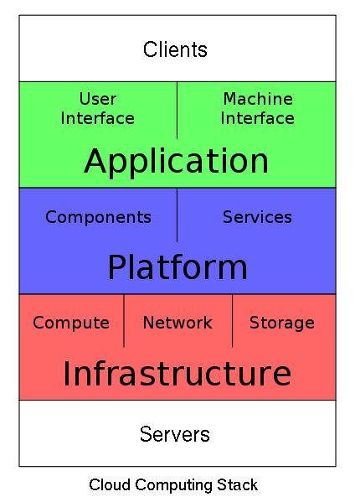
Service Models (cont.)
Service Model at a glance: Picture From http://en.wikipedia.org/wiki/File:Cloud_Computing_Stack.svg

Slide 9
Deployment Models

Slide 10
Private Cloud:
The cloud is operated solely for an organization. It may be managed by the organization or a third party and may exist on premise or off premise.
Community Cloud:
The cloud infrastructure is shared by several organizations and supports a specific community that has shared concerns.
It may be managed by the organizations or a third party and may exist on premise or off premise

Slide 11
Public Cloud:
The cloud infrastructure is made available to the general public or a large industry group and it is owned by an organization selling cloud services.
Hybrid cloud:
The cloud infrastructure is a composition of two or more clouds (private, community, or public).

Slide 12
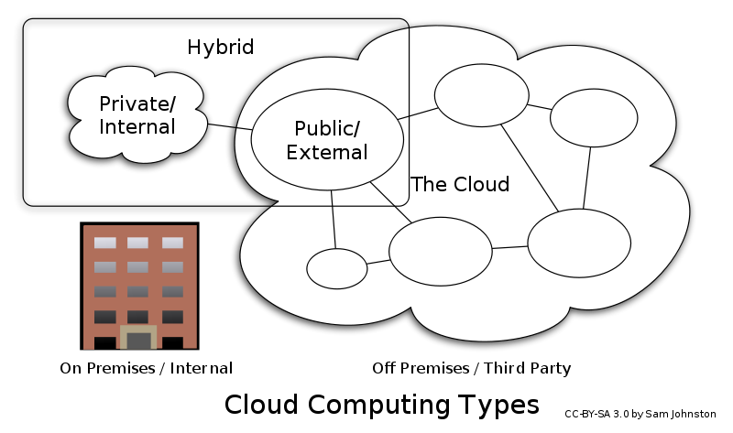

Slide 13
Advantages of Cloud Computing
Cloud computing do not need high quality equipment for user, and it is very easy to use.
Provides dependable and secure data storage center.
Reduce run time and response time.
Cloud is a large resource pool that you can buy on-demand service.
Scale of cloud can extend dynamically providing nearly infinite possibility for users to use internet.

Slide 14

Infrastructure as a Service (IaaS) Amazon EC2
Notes:
The Challenge of the Computer Utility - Douglas F. Parkhill

Slide 15
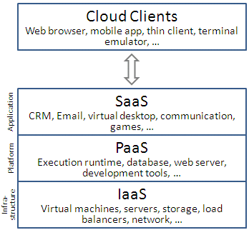
What is Infrastructure as a Service ?
A category of cloud services which provides capability to provision processing, storage, intra-cloud network connectivity services, and other fundamental computing resources of the cloud infrastructure. Source- [ITU –Cloud Focus Group]
Diagram Source: Wikipedia
Notes:
IaaS clouds often offer additional resources such as a virtual-machine disk image library, raw (block) and file-based storage, firewalls, load balancers, IP addresses, VLANs, and software bundles

Slide 16
Highlights of IaaS
On demand computing resources
Eliminate the need of far ahead planning
No up-front commitment
Start small and grow as required
No contract, Only credit card!
Pay for what you use
No maintenance
Measured service
Scalability
Reliability
Notes:
illusion of inﬁnite computing resources available on demand
EC2 instance looks much like physical hardware, and users can control nearly the entire software stack, from the kernel upwards

Slide 17
What is EC2 ?
Amazon Elastic Compute Cloud (EC2) is a web service that provides resizeable computing capacity that one uses to build and host different software systems.
Designed to make web-scale computing easier for developers.
A user can create, launch, and terminate server instances as needed, paying by the hour for active servers, hence the term "elastic".
Provides scalable, pay as-you-go compute capacity
Elastic - scales in both direction

Slide 18
EC2 Infrastructure Concepts

Slide 19
EC2 Concepts
AMI & Instance
Region & Zones
Storage
Networking and Security
Monitoring
Auto Scaling
Load Balancer

Slide 20
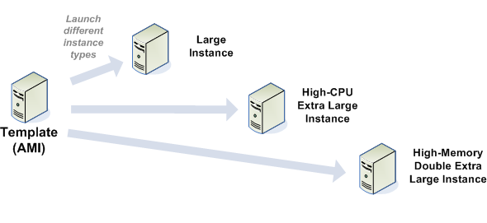
Amazon Machine Images (AMI)
Is an immutable representation of a set of disks that contain an operating system, user applications and/or data.
From an AMI, one can launch multiple instances, which are running copies of the AMI.

Slide 21
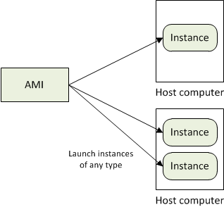
AMI and Instance
Amazon Machine Image (AMI) is a template for software configuration (Operating System, Application Server, and Applications)
Instance is a AMI running on virtual servers in the cloud
Each instance type offers different compute and memory facilities
Diagram Source: http://docs.aws.amazon.com
Notes:
Amazon publishes many AMI for public use
Custom AMIs provided by community members
User can create their own AMI
Instance type – different operating environment.
Amazon’s bet is that by statistically multiplexing multiple instances onto a single physical box, that box can be simultaneously rented to many customers who will not in general interfere with each others’ usage (see Section 7).

Slide 22
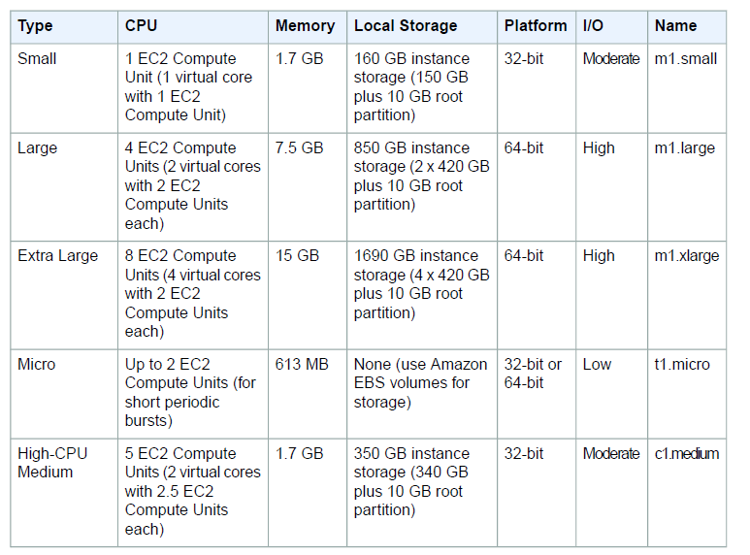

Slide 23
Region and Zones
Amazon have data centers in different region across the globe
An instance can be launched in different regions depending on the need.
Closer to specific customer
To meet legal or other requirements
Each region has set of zones
Zones are isolated from failure in other zones
Inexpensive, low latency connectivity between zones in same region
Notes:
for example, North America, Europe, and Asia).
Prices for Amazon EC2 usage vary by region
Each region contains multiple distinct locations called Availability Zones.

Slide 24
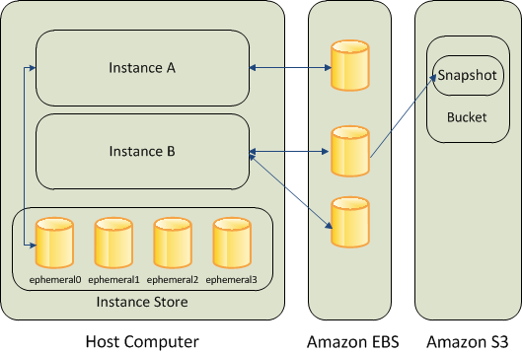
Storage
Amazon EC2 provides three type of storage option
Amazon EBS
Amazon S3
Instance Storage
Diagram Source: http://docs.aws.amazon.com
Notes:
Amazon EBS (Elastic Block Store) provides with persistent, block-level storage. Basically additional Hard Disk that you can attach to instance.
Suitable for apps which require database , filesystem , block level storage.
Create, Attach , Detach, Delete
- Standard volumes and Provisioned IOPS volumes.
Take snapshots that is stored in S3 , a new EBS can be re-created using the snapshot
Instance store comes with each instance except the micro-one , temporary block level storage.
Storage physically attached to the computer
S3 simple storage service
storage for the Internet
web service interface that enables you to store and retrieve any amount of data from anywhere on the web
Root device storage: contains image to boot the system
AMI categorized as “Backed by Amazon EBS” or “Backed by instance store”

Slide 25
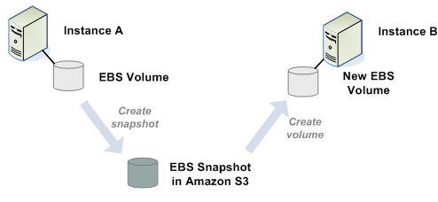
Elastic Block Store(EBS) volume
An EBS volume is a read/write disk that can be created by an AMI and mounted by an instance.
Volumes are suited for applications that require a database, a file system, or access to raw block-level storage.

Slide 26
Amazon S3
S3 = Simple storage Service
A SOA – Service Oriented Architecture which provides online storage using web services.
Allows read, write and delete permissions on objects.
Uses REST and SOAP protocols for messaging.

Slide 27
Amazon SimpleDB
Amazon SimpleDB is a highly available, flexible, and scalable non-relational data store that offloads the work of database administration.
Creates and manages multiple geographically distributed replicas of your data automatically to enable high availability and data durability.
The service charges you only for the resources actually consumed in storing your data and serving your requests.

Slide 28
Networking and Security
Instances can be launched on one of the two platforms
EC2-Classic
EC2-VPC
Each instance launched is assigned two addresses a private address and a public IP address.
A replacement instance has a different public IP address.
Instance IP address is dynamic.
new IP address is assigned every time instance is launched
Amazon EC2 offers Elastic IP addresses (static IP addresses) for dynamic cloud computing.
Remap the Elastic IP to new instance to mask failure
Separate pool for EC2-Classic and VPC
Security Groups to access control to instance
Notes:
VPC - launch Amazon Web Services (AWS) resources into a virtual network that you've defined.
Configure VPC: select its IP address range, create subnets, and configure route tables, network gateways, and security settings.
Security Group - enables you to specify the protocols, ports, and source IP ranges that are allowed to reach your instances
Create multiple security groups , assign instance to a particular group , determine the traffic

Slide 29
Monitoring, Auto Scaling, and Load Balancing
Monitor statistics of instances and EBS
CloudWatch
Automatically scales amazon EC2 capacity up and down based on rules
Add and remove compute resource based on demand
Suitable for businesses experiencing variability in usage
Distribute incoming traffic across multiple instances
Elastic Load Balancing
Notes:
CloudWatch
Monitor, manage, and publish various metrics
Configure Alarms based on metrics

Slide 30
How to access EC2
AWS Console
http://console.aws.amazon.com
Command Line Tools
Programmatic Interface
EC2 APIs
AWS SDK

Slide 31
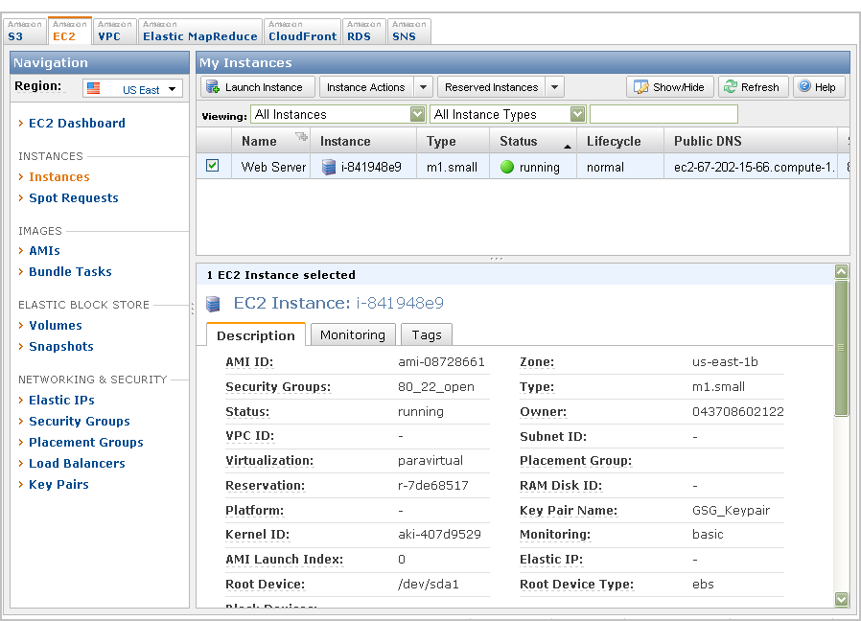
AWS Management Console

Slide 32
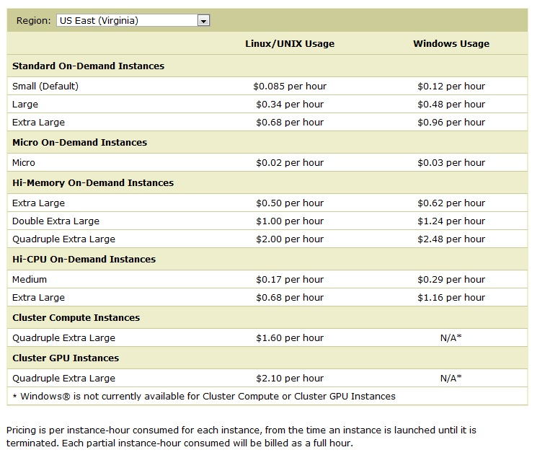

Slide 33
References
Mobile cloud computing: Big Picture by M. Reza Rahimi
http://aws.amazon.com/ec2, http://docs.aws.amazon.com
Amazon Elastic Compute Cloud – User Guide, API Version 2011-02-28.
Above the Clouds: A Berkeley View of Cloud Computing - Michael Armbrust et.al 2009
International telecommunication union – Focus Group Cloud Technical Report

Slide 34


Hadoop, a distributed framework for Big Data

Slide 35

Introduction
Introduction: Hadoop’s history and advantages
Architecture in detail
Hadoop in industry

Slide 36

What is Hadoop?
Apache top level project, open-source implementation of frameworks for reliable, scalable, distributed computing and data storage.
It is a flexible and highly-available architecture for large scale computation and data processing on a network of commodity hardware.
Designed to answer the question: “How to process big data with reasonable cost and time?”

Slide 37
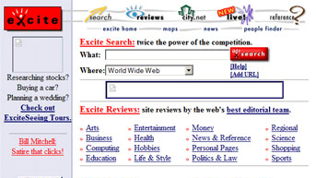
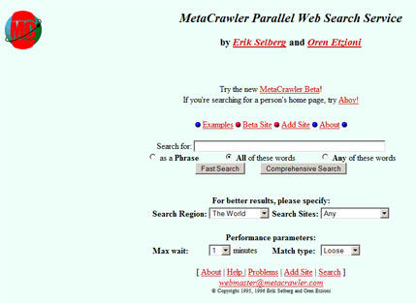
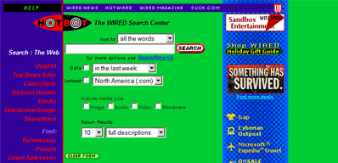
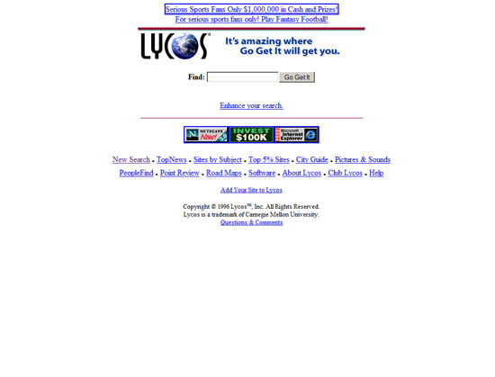
Search engines in 1990s
1996
1996
1996
1997

Slide 38
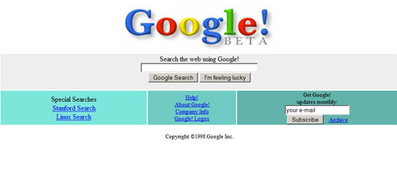
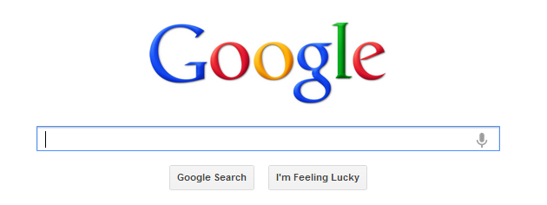
Google search engines
1998
2013

Slide 39


Hadoop’s Developers
2005: Doug Cutting and Michael J. Cafarella developed Hadoop to support distribution for the Nutch search engine project.
The project was funded by Yahoo.
2006: Yahoo gave the project to Apache
Software Foundation.

Slide 40
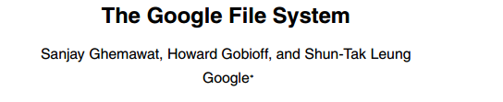

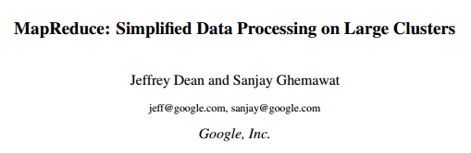


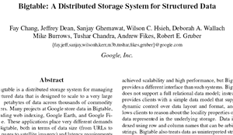
Google Origins
2003
2004
2006

Slide 41
Some Hadoop Milestones
2008 - Hadoop Wins Terabyte Sort Benchmark (sorted 1 terabyte of data in 209 seconds, compared to previous record of 297 seconds)
2009 - Avro and Chukwa became new members of Hadoop Framework family
2010 - Hadoop's Hbase, Hive and Pig subprojects completed, adding more computational power to Hadoop framework
2011 - ZooKeeper Completed
2013 - Hadoop 1.1.2 and Hadoop 2.0.3 alpha.
- Ambari, Cassandra, Mahout have been added

Slide 42
What is Hadoop?
An open-source software framework that supports data-intensive distributed applications, licensed under the Apache v2 license.
Abstract and facilitate the storage and processing of large and/or rapidly growing data sets
Structured and non-structured data
Simple programming models
High scalability and availability
Use commodity (cheap!) hardware with little redundancy
Fault-tolerance
Move computation rather than data

Slide 43
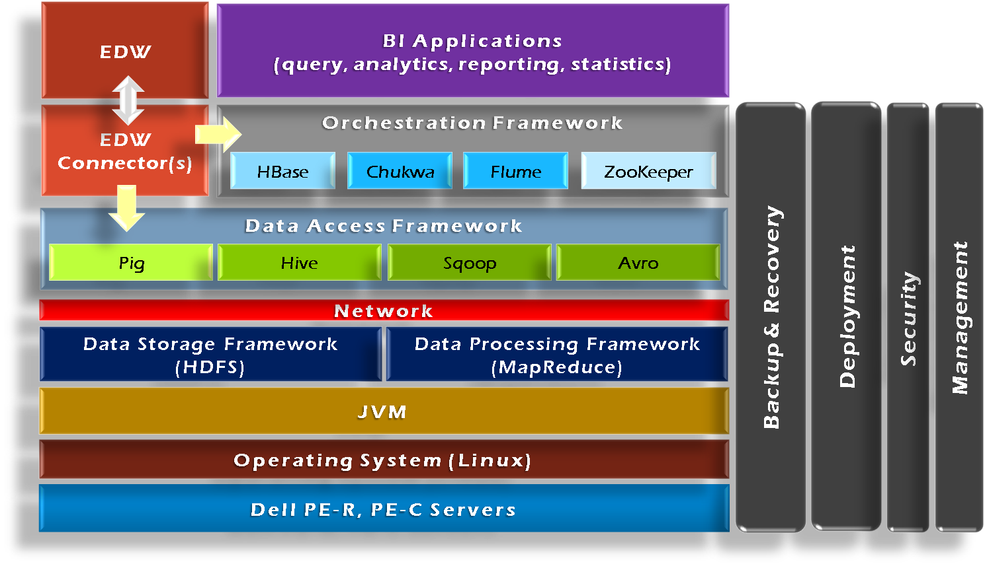
Hadoop Framework Tools

Slide 44
Hadoop MapReduce Engine
A MapReduce Process (org.apache.hadoop.mapred)
JobClient
Submit job
JobTracker
Manage and schedule job, split job into tasks;
Splits up data into smaller tasks(“Map”) and sends it to the TaskTracker process in each node
TaskTracker
Start and monitor the task execution;
reports back to the JobTracker node and reports on job progress, sends data (“Reduce”) or requests new jobs
Child
The process that really executes the task

Slide 45
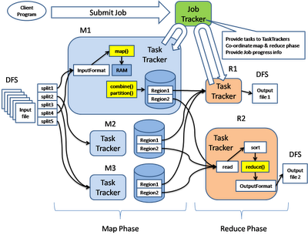
Hadoop’s Architecture: MapReduce Engine

Slide 46
Hadoop’s MapReduce Architecture
Distributed, with some centralization
Main nodes of cluster are where most of the computational power and storage of the system lies
Main nodes run TaskTracker to accept and reply to MapReduce tasks, Main Nodes run DataNode to store needed blocks closely as possible
Central control node runs NameNode to keep track of HDFS directories & files, and JobTracker to dispatch compute tasks to TaskTracker
Written in Java, also supports Python and Ruby

Slide 47
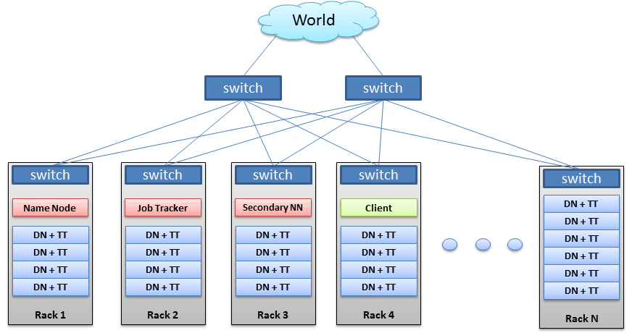
Hadoop’s Architecture

Slide 48
Hadoop Distributed FileSystem
Tailored to needs of MapReduce
Targeted towards many reads of filestreams
Writes are more costly
Open Data Format
Flexible Schema
Queryable Database
Fault Tolerance
High degree of data replication (3x by default)
No need for RAID on normal nodes
Large blocksize (64MB)
Location awareness of DataNodes in network

Slide 49
HDFS
NameNode:
Stores metadata for the files, like the directory structure of a typical FS.
The server holding the NameNode instance is quite crucial, as there is only one.
Transaction log for file deletes/adds, etc. Does not use transactions for whole blocks or file-streams, only metadata.
Handles creation of more replica blocks when necessary after a DataNode failure
DataNode:
Stores the actual data in HDFS
Can run on any underlying filesystem (ext3/4, NTFS, etc)
Notifies NameNode of what blocks it has
NameNode replicates blocks 2x in local rack, 1x elsewhere

Slide 50
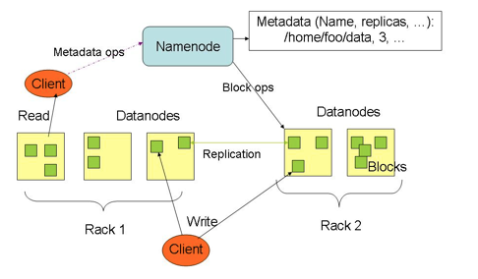
HDFS

Slide 51
HDFS Replication
Replication Strategy:
One replica on local node
Second replica on a remote rack
Third replica on same remote rack
Additional replicas are randomly placed
Clients read from nearest replica
Use Checksums to validate data – CRC32
File Creation
Client computes checksum per 512 byte
DataNode stores the checksum
File Access
Client retrieves the data anD checksum from DataNode
If validation fails, client tries other replicas
Client retrieves a list of DataNodes on which to place replicas of a block
Client writes block to the first DataNode
The first DataNode forwards the data to the next DataNode in the Pipeline
When all replicas are written, the client moves on to write the next block in file

Slide 52
Hadoop Usage
Hadoop is in use at most organizations that handle big data:
Yahoo!
Yahoo!’s Search Webmap runs on 10,000 core Linux cluster and powers Yahoo! Web search
Facebook
FB’s Hadoop cluster hosts 100+ PB of data (July, 2012) & growing at ½ PB/day (Nov, 2012)
Amazon
Netflix
Key Applications
Advertisement (Mining user behavior to generate recommendations)
Searches (group related documents)
Security (search for uncommon patterns)

Slide 53
Hadoop Usage
Non-realtime large dataset computing:
NY Times was dynamically generating PDFs of articles from 1851-1922
Wanted to pre-generate & statically serve articles to improve performance
Using Hadoop + MapReduce running on EC2 / S3, converted 4TB of TIFFs into 11 million PDF articles in 24 hrs

Slide 54
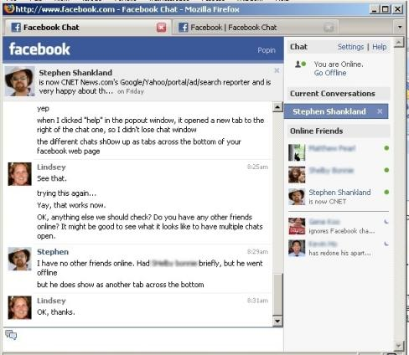
Hadoop Usage: Facebook Messages
Design requirements:
Integrate display of email, SMS and chat messages between pairs and groups of users
Strong control over who users receive messages from
Suited for production use between 500 million people immediately after launch
Stringent latency & uptime requirements

Slide 55
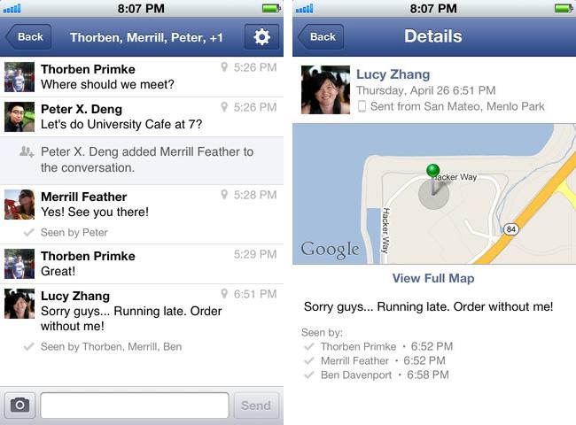
Hadoop Usage: Facebook Messages
System requirements
High write throughput
Cheap, elastic storage
Low latency
High consistency (within a single data center good enough)
Disk-efficient sequential and random read performance

Slide 56
Hadoop Usage: Facebook Messages
Classic alternatives
These requirements typically met using large MySQL cluster & caching tiers using Memcache
Content on HDFS could be loaded into MySQL or Memcached if needed by web tier
Problems with previous solutions
MySQL has low random write throughput… BIG problem for messaging!
Difficult to scale MySQL clusters rapidly while maintaining performance
MySQL clusters have high management overhead, require more expensive hardware

Slide 57
Hadoop Usage: Facebook Messages
Facebook’s solution
Hadoop + HBase as foundations
Improve & adapt HDFS and HBase to scale to FB’s workload and operational considerations
Major concern was availability: NameNode is SPOF & failover times are at least 20 minutes
Proprietary “AvatarNode”: eliminates SPOF, makes HDFS safe to deploy even with 24/7 uptime requirement
Performance improvements for realtime workload: RPC timeout. Rather fail fast and try a different DataNode

Slide 58
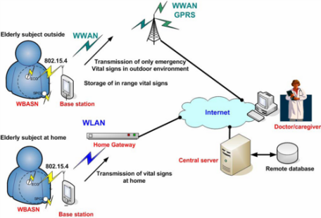
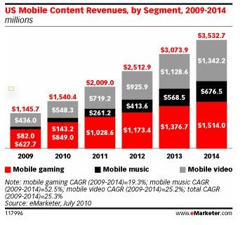


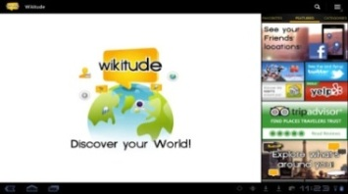



Cloud Computing for Mobile
and Pervasive Applications
Sensory Based Applications
Location Based Services (LBS)
Mobile Music: 52.5%
Mobile Video:25.2%
Mobile Gaming: 19.3%
Augmented Reality
Mobile Social
Networks and
Crowdsourcing
Multimedia and
Data Streaming
Due to limited resources on mobile devices,
we need outside resources to empower mobile apps.

Slide 59
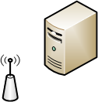










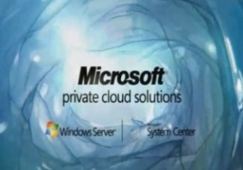





Mobile Cloud Computing
Ecosystem
Public Cloud Providers
Local and Private
Cloud Providers
Wired and Wireless
Network Providers
Content and Service
Providers
Devices, Users
and Apps

Slide 60





2-Tier Cloud Architecture
Tier 1: Public Cloud
(+) Scalable and Elastic
(-) Price, Delay
Tier 2: Local Cloud
(+) Low Delay, Low Power,
(-) Not Scalable and Elastic
RTT:
~290ms
3G Access
Point
Wi-Fi Access
Point
RTT:
~80ms
IBM: by 2017 61% of
enterprise is likely to be on
a tiered cloud

Slide 61
Mobile Cloud Computing
Ecosystem
Public Cloud Providers
Local and Private
Cloud Providers
Wired and Wireless
Network Providers
Content and Service
Providers
Devices, Users
and Apps

Slide 62
How can we Optimally and Fairly assign services to mobile users using a 2-tier cloud architecture (knowing user mobility pattern) considering power consumed on mobile device, delay users experience and price as the main criteria for optimization.
Modeling Mobile Apps
Mobility-Aware Service Allocation Algorithms
Scalability
Middleware Architecture and System Design

Slide 63

Modeling Mobile Applications as Workflows
.Model apps as consisting of a series of logical steps known as a Service with different composition patterns:
k
S1
S2
S3
S1
SEQ
LOOP
1
S3
P1
S3
S1
S4
S1
S4
1
S2
P2
S2
$$P_{1}+P_{2}=1, {P_{1},P}_{2}∈\{0,1\}$$
AND: CONCURRENT FUNCTIONS
XOR: CONDITIONAL FUNCTIONS
3
S3
Par1
S6
0
Start
S1
S4
S5
S8
End
1
S2
Par2
S7

Slide 64
Modeling Mobile Applications as Workflows
t₁
t₂
t₃
t₄
t_{N}
l₁
W₁
l₂
W_{k+1}
W_{j+1}
W_{j}
l₃
W_{k}
l_{n}
Location-Time Workflow
It could be formally defined as:
${{W(u_{k})}_{Τ}}^{L}≝({{w\left(u_{k}\right)}_{t_{m_{1}}}}^{l_{n_{1}}},{{w\left(u_{k}\right)}_{t_{m_{2}}}}^{l_{n_{2}}}$,….,${{w\left(u_{k}\right)}_{t_{m_{k}}}}^{l_{n_{k}}})$

Slide 65
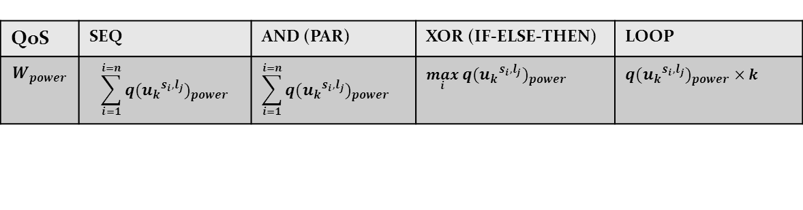
Quality of Service (QoS)
The QoS could be defined in two different Levels:
Atomic service level
Composite service level or workflow level.
Atomic service level could be defined as (for power as an example):
$${q({u_{k}}^{s_{i},l_{j}})}_{power}$$ | power consumed on $u_{k}$ cellphone when he is in l$ocation l_{j}$ using $s_{i}$.
The workflow QoS is based on different patterns.
QoS | SEQ | AND (PAR) | XOR (IF-ELSE-THEN) | LOOP
$$W_{power}$$ | $$\sum_{i=1}^{i=n}{{q({u_{k}}^{s_{i},l_{j}})}_{power}}$$ | $$\sum_{i=1}^{i=n}{{q({u_{k}}^{s_{i},l_{j}})}_{power}}$$ | $$\max_{i}{{q({u_{k}}^{s_{i},l_{j}})}_{power}}$$ | $${q({u_{k}}^{s_{i},l_{j}})}_{power}×k$$

Slide 66
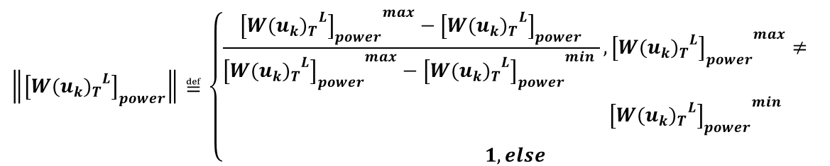
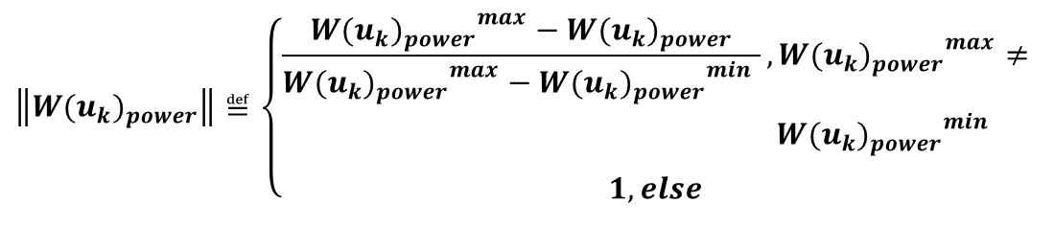
Normalization
different QoSes have different dimensions (Price->$, power->joule, delay->s)
We need a normalization process to make them comparable.
$$\left\|{W(u_{k})}_{power}\right\|≝\left\{\begin{aligned}\begin{aligned}\begin{aligned}\frac{{{W(u_{k})}_{power}}^{max}−{W(u_{k})}_{power}}{{{W(u_{k})}_{power}}^{max}−{{W(u_{k})}_{power}}^{min} },{{W(u_{k})}_{power}}^{max}≠ \\ {{W(u_{k})}_{power}}^{min}\end{aligned} \\ \end{aligned} \\ &1, else\end{aligned}\right.$$
The normalized power, price and delay is the real number in interval [0,1].
The higher the normalized QoS the better the execution plan is.
$$\left\|{\left[{{W(u_{k})}_{Τ}}^{L}\right]}_{power}\right\|≝\left\{\begin{aligned}\begin{aligned}\begin{aligned}\frac{{{\left[{{W(u_{k})}_{Τ}}^{L}\right]}_{power}}^{max}−{\left[{{W(u_{k})}_{Τ}}^{L}\right]}_{power}}{{{\left[{{W(u_{k})}_{Τ}}^{L}\right]}_{power}}^{max}−{{\left[{{W(u_{k})}_{Τ}}^{L}\right]}_{power}}^{min} },{{\left[{{W(u_{k})}_{Τ}}^{L}\right]}_{power}}^{max}≠ \\ {{\left[{{W(u_{k})}_{Τ}}^{L}\right]}_{power}}^{min}\end{aligned} \\ \end{aligned} \\ &1, else\end{aligned}\right.$$
M. Reza. Rahimi, Nalini Venkatasubramanian, Sharad Mehrotra and Athanasios Vasilakos, "MAPCloud: Mobile Applications on an Elastic and Scalable 2-Tier Cloud Architecture", In the 5th IEEE/ACM International Conference on Utility and Cloud Computing (UCC 2012), USA, Nov 2012.

Slide 67

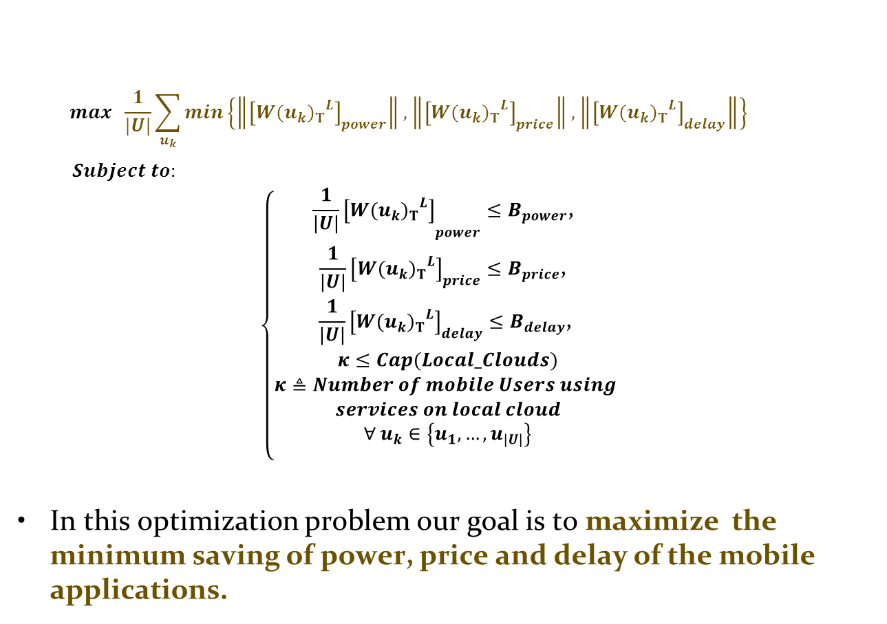
Optimal Service Allocation for Single Mobile User
$$Fairness Utility$$
$$max \frac{1}{|U|}\sum_{u_{k}}{min\left\{\left\|{\left[{{W(u_{k})}_{Τ}}^{L}\right]}_{power}\right\|, \left\|{\left[{{W(u_{k})}_{Τ}}^{L}\right]}_{price}\right\|,\left\|{\left[{{W(u_{k})}_{Τ}}^{L}\right]}_{delay}\right\|\right\}}$$
$Subject to:$
$$\left\{\begin{aligned}{\frac{1}{|U|}\left[{{W(u_{k})}_{Τ}}^{L}\right]}_{power}≤B_{power}\text{, } \\ \frac{1}{|U|}{\left[{{W(u_{k})}_{Τ}}^{L}\right]}_{price}≤B_{price}\text{, } \\ \frac{1}{|U|}{\left[{{W(u_{k})}_{Τ}}^{L}\right]}_{delay}≤B_{delay}\text{, } \\ κ≤Cap(Local_Clouds) \\ κ≜Number of mobile Users using \\ services on local cloud \\ ∀ u_{k}∈\left\{u_{1},…,u_{|U|}\right\} \\ \end{aligned}\right.$$
In this optimization problem our goal is to maximize the minimum saving of power, price and delay of the mobile applications.

Slide 68

Service Allocation Algorithms for
Single Mobile User and Mobile Group-Ware
Applications
Brute-Force Search (BFS)
Random Service Allocation (RSA)
Greedy Based
Simulated Annealing Based
Genetic Based
MuSIC: Mobility Aware Service AllocatIon on Cloud.
based-on a simulated annealing approach.

Slide 69

MAPCloud Middleware
Architecture
Cloud Service Registry
Mobile Client
Local and Public Cloud Pool
MAPCloud Runtime
MAPCloud Web Service Interface
QoS-Aware Service DB
Mobile User Log DB
MAPCloud LTW Engine
MAPCloud Web Service Interface
Optimal Service Scheduler
MAPCloud Middleware

Slide 70
M. Satyanarayanan, P. Bahl, R. Cáceres, N. Davies " The Case for VM-Based Cloudlets in Mobile Computing",PerCom 2009.
M. Reza Rahimi, Jian Ren, Chi Harold Liu, Athanasios V. Vasilakos, and Nalini Venkatasubramanian, "Mobile Cloud Computing: A Survey, State of Art and Future Directions", in ACM/Springer Mobile Application and Networks (MONET), Special Issue on Mobile Cloud Computing, Nov. 2013.
Reza Rahimi, Nalini Venkatasubramanian, Athanasios Vasilakos, "MuSIC: On Mobility-Aware Optimal Service Allocation in Mobile Cloud Computing", In the IEEE 6th International Conference on Cloud Computing, (Cloud 2013), Silicon Valley, CA, USA, July 2013

